Slide 1


Social Buzz

Slide 2


Today's agenda
We are gathered here to help Social buzz with their business problem
Will have in detail look at issues that out client is facing currently
Will understand our stake holders and analytical team which will help our client to solve their business problem
Steps that we have taken to reach our conclusion
Final Outcome
Suggestions

Slide 3


Business Problem:
The Client - "Social Buzz" has reached a massive scale within recent years and does not have the resources internally to handle it.
Project Recap
Notes:
Client Name: Social Buzz

Slide 4


Problem
Key areas:
Audit of big data practice
Recommendations for IPO
Analysis of popular contents
Notes:
Shifting to bid data , need to identify best practices as they do not have them
Wanted to start IPO and needed help in journey to be successful
Have a vast content available , need help to understand top 5 category trends to focus and improve overall

Slide 5



Andrew Fleming (Chief Technical Architect)
The Analytics team
Marcus Rompton (Senior Principle)
Sneha Pasalkar (Data Analyst)
Notes:
Social media industry experts
IPO experts
Our data experts

Slide 6
We have 7 data sets and a data model
Identify data sets that can help us solve the requirement using data model
Identified data sets are : Reaction, content, reaction type
Data cleaning
Data modeling
Identify top 5 categories
Process

Slide 7

Basic Data Insights
Total 16
Animals, science, etc
Content Type
Photo
Audio
Gif
Video
Category types
Scoring system
0 to 75
Sentiment types
Negative
Neutral
Positive

Slide 8
Data Analysis Insights
Animals
Science
Healthy eating
Technology
Food
Top 5 category
Notes:
Top 5 trending categories

Slide 9
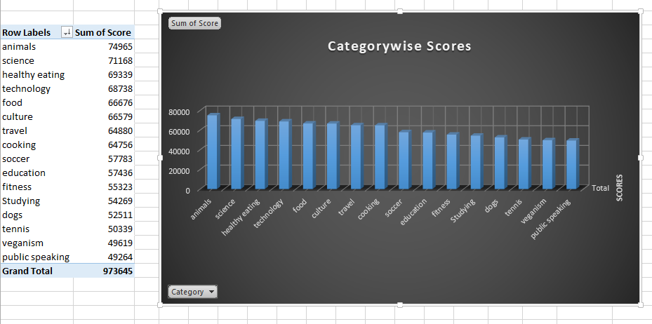

Slide 10
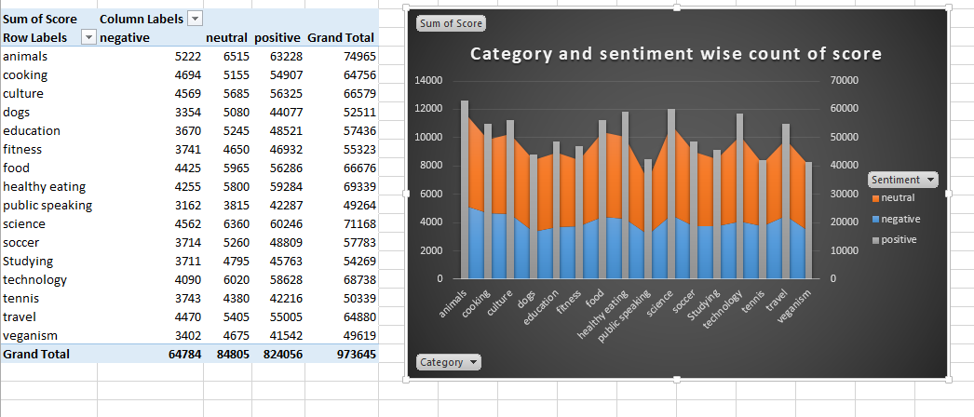

Slide 11
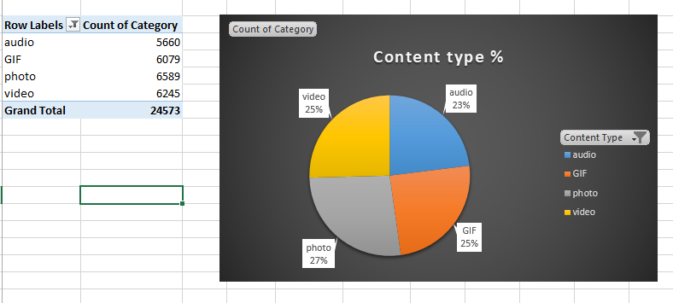

Slide 12
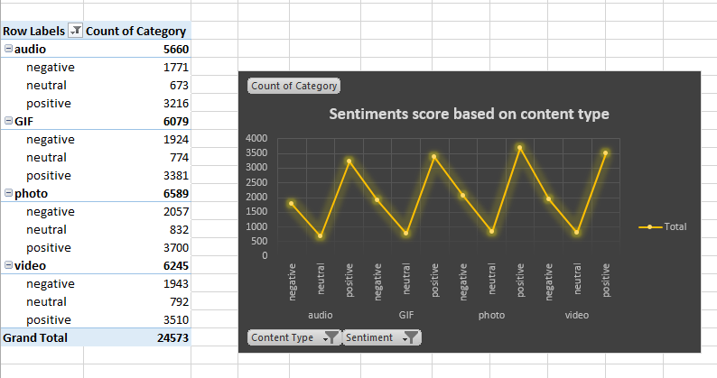

Slide 13
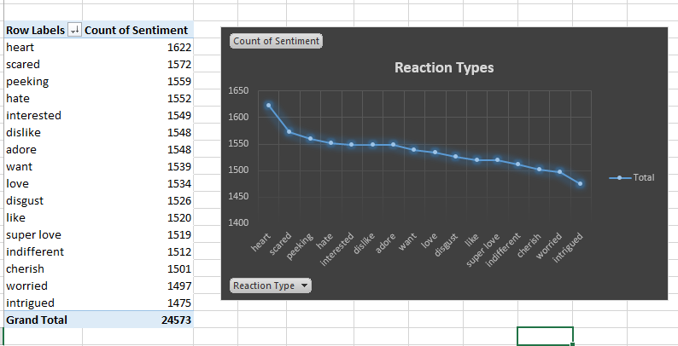

Slide 14
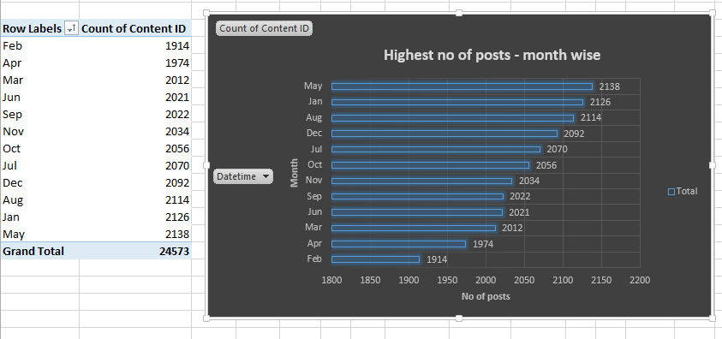

Slide 15


Summary
Animals
Health Eating
Food
Science
Technology
Analysis: Animals, Science, Healthy eating, technology and food are our top 5 categories. Here we an combine Healthy eating and food together and Science and technology together as they share similarities.
Insights: Our analysis suggest that we should work on concepts about healthy eating, welfare of animals and tech savvy ideas to improve user base, we should also focus on our target audience related to these top 5 categories so that overall performance of social buzz will be improved, Team should work around campaigns related to our 5 categories on priority as per trend so that client can get good user involvement.
Further steps:
In this we can have a survey done from registered user about there experiences and if any area where they are facing issues, we can also check the root cause using feedback form if a user is visiting login page but not signing up, we need to understand other aspects of the user involvement too like age group, common points of likes, etc so that we can work on the same going ahead, we at Accenture will definitely help "Social Buzz" to achieve their goal.

Slide 16

Thank you!
ANY QUESTIONS?

